Slide 1

Period End Closing Execution (BSC)
Period End Closing Key Process Areas and New Period End Checks
Posting Period Control
Intercompany and Period End Closing
Lease Accounting and Period End Closing
Cost Management Closing Activities
Period End Closing for Accruals and Recurring Entries
Period End Data Checks
Asset Accounting Closing Activities
VAT Clearing and Reporting
GR/IR Closing Activities
Material Ledger Closing (Non-GSC Activities)
Automatic Clearing of LSC¹⁾ Accounts
G/L Closing Activities for Financial Statement Preparation
¹⁾ LSC – Accounts with indicator “Clearing Specific to Ledger Groups” active.

Slide 2
Period End Closing Key Process Areas and New Period End Checks
Currency Revaluation
G/L Closing Activities for Financial Statement Preparation
AP/AR Regrouping
Currency Translation
Functional Area Adjustment

Slide 3
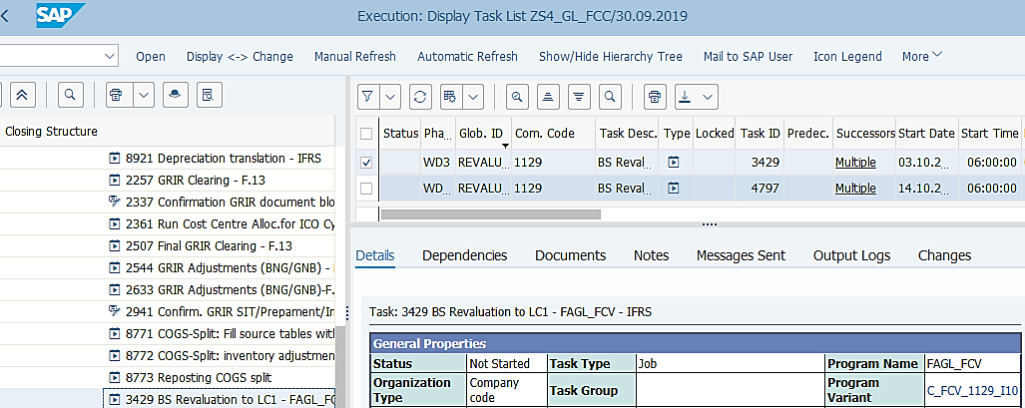
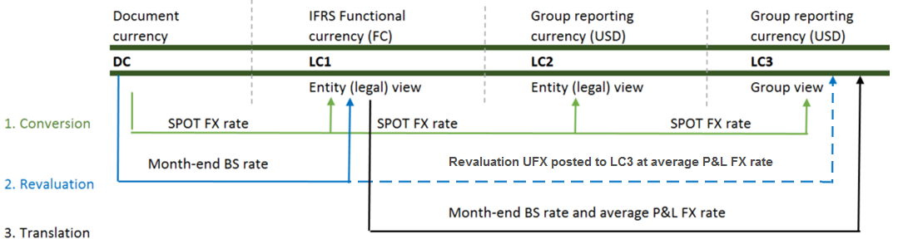
Currency Revaluation Period End Process Overview
Basic Process of Currency Revaluation
Revaluation is the process at period end for foreign currency monetary items to be revaluated from Document Currency to LC1 at balance sheet date exchange rate (JT Rate)
In S/4HANA the Core Principles on FX Rate sources, FX Rate trigger dates and Revaluation calculations remain unchanged.
At period end all B/S Monetary items with DC ≠ LC1 are to be revaluated from DC to LC1 so that Revaluated LC1 = DC @ JT Rate.
Revaluation posts UFX (B/S and P&L) in LC1 and in LC3 (LC3=LC1@ RM rate).
Revaluation is performed separately for different ledgers as per closing calendar. To meet the different revaluation calculation requirements in different ledgers, Valuation Areas¹⁾ are used.
The variants used in Revaluation transaction are unique to each entity but they all use variables for dates/periods/years fields. You should always check/amend the values of these fields to ensure they are correct before executing Revaluation outside of FCC.
¹⁾ Details on Valuation Areas and Revaluation Calculation Methods are available in Parallel Ledger training course.
T-Code:
FAGL_FCV
There should be more than one Revaluation tasks per entity as this is executed for each ledger using the corresponding Valuation Area, which determines the valuation calculation method, the rate and how postings should be made. Depending on the STAT and TAX ledger requirements, some entities may not have a Revaluation task for each ledger.
In S/4 HANA, the transaction will post the documents simultaneously with only erroneous entries sent to a Batch Input session for user to process.
FCC Task: Entity Level
The Revaluation tasks are set at entity level.
Timing: WD3 – IFRS
WD10 – STAT/TAX
Revaluations are to be performed as one of the final financial statements preparation tasks, which will be on WD3 for IFRS and WD10 for STAT/TAX.

Slide 4
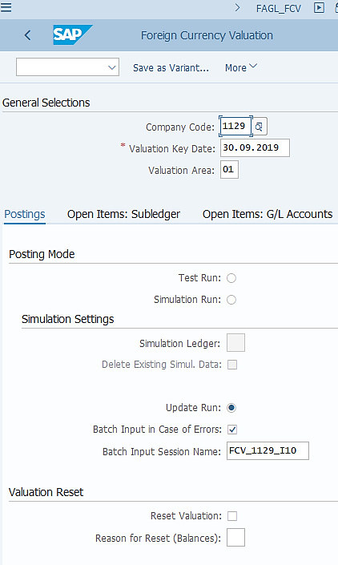
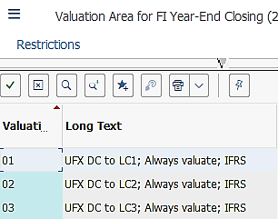
Currency Revaluation: Execution (1/4)
FAGL_FCV: Revaluation – Postings tab
Transaction FAGL_FCV is new in S/4 HANA. There are many similar fields which were in the ECC Revaluation transaction but also some new features which are described here and the next few slides. Make sure you use the same Variant as stated in the FCC task if you execute this transaction outside of FCC.
Revaluation is executed for one entity at a time. Variants for each revaluation requirements of each entity has been created. If you have a new requirement you should liaise with the entity and BTS to have the new variant created and updated in FCC.
The Valuation Key Date should always be the Balance Sheet date of the month that is being closed.
Value Area determines how the revaluation is to be calculated. We use different Valuation Areas for different Accounting Principles (E.g. IFRS, STAT, Tax). As a general guide:
- 01, 02, 03: for IFRS. Majority of the entities use 01.
- S1 to S7: for Statutory Currency Revaluation based on different statutory reporting requirements.
- T1 to T7: for Tax Currency Revaluation based on different tax reporting requirements.
Test Run should be selected if you execute Revaluation outside of FCC for any reason. This allows you to check if there’s any errors which you should fix before executing the transaction in update run.
Update run is set in the FCC variant but as stated before you should Test run first if you execute the transaction outside of FCC.
In S/4HANA when the Revaluation transaction is executed, the revaluation accounting entries are posted simultaneously. A batch input session is only going to be generated if there are accounting entries which can’t be posted due to any errors.
The Batch Input session name in each variant matches the name of the variant for easy identification in SM35.
These fields need to be populated in case you wish to reset a previous Revaluation run. You should populate other fields based on the actual Revaluation run you wish to reverse, otherwise you may be reversing a wrong Revaluation Run.
This will reverse the revaluation postings, which is why you need to provide a Reason for Reset. Make sure you consult your GL Team Lead or the person in charge of closing before resetting any revaluation.

Slide 5
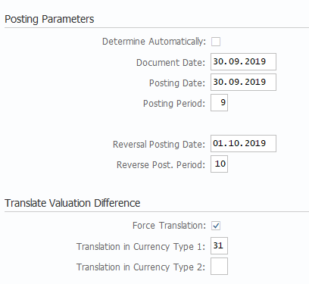
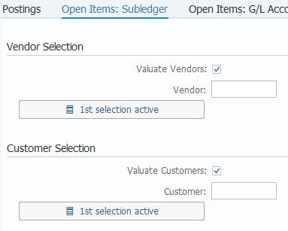
Currency Revaluation: Execution (2/4)
FAGL_FCV: Revaluation – Postings tab
Revaluation should be posted on the last date of the month that is being closed.
Most of the revaluation postings are to be reversed on the first date of the following period, however some STAT and/or TAX accounting principles require revaluation not to be reversed. These are defined in the Valuation Area (the S* and T* areas) and set up accordingly in the Revaluation Variants.
In case you are not sure what has been set up for your company code you can always approach BTS for this information.
IFRS Revaluation Variants using Valuation Area 01 has these two fields populated as shown on the screenshot. This means that when revaluation difference (UFX-Unrealized FX differences) are posted to LC1, they are also posted to LC3 (Currency Type 31) at the same time and the value in LC3 is translated from the value posted in LC1 at the monthly average (RM) rate.
For other Revaluation Variants, these fields may not be used. This depends on the actual requirement of each requirement, especially for STAT and Tax ledgers.
Entities that use USD as functional currency but not LC1 do not normally have these fields populated. In these cases Revaluations are performed for LC1 and LC2 (in STAT/TAX ledger) or LC3 (in IFRS ledger) as target currencies separately, which do not require any “Force Translation” from LC1.
FAGL_FCV: Revaluation – Open Items: Subledger tab
In Revaluation runs, we select all vendors and customers, with the exceptions of some accounts, which some restrictions set in the “Display selection”, which we will take a look later.

Slide 6
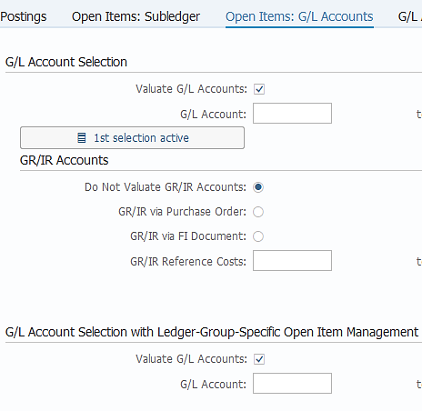
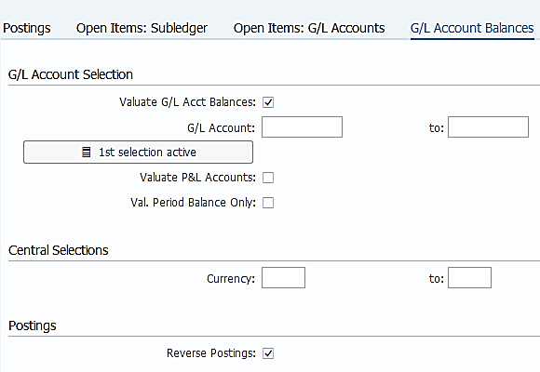
Currency Revaluation: Execution (3/4)
FAGL_FCV: Revaluation – Open Items: G/L Accounts tab
These selections mean that we revaluate G/L accounts with Open Item Management or Clearing Specific to Ledger Groups indicators activated in their G/L Master Data. There is also a “Display selection” criterion activated for the G/L Open Items accounts selection, which we will take a look later.
These selections mean that we revaluate G/L accounts which are not managed with open/cleared items. These are revaluated by the G/L account balances by each document currency. There is a “Display selection” criterion activated here for restriction of G/L accounts which are to be valuated based on balances, which we will take a look later.
FAGL_FCV: Revaluation – G/L Account Balances tab
For the variants which require the revaluation postings to be reversed on the specified Reversal Date (on Postings tab), this checkbox needs to be ticked so that reversal postings can take place accordingly.

Slide 7
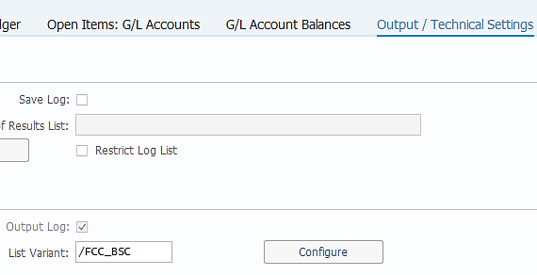

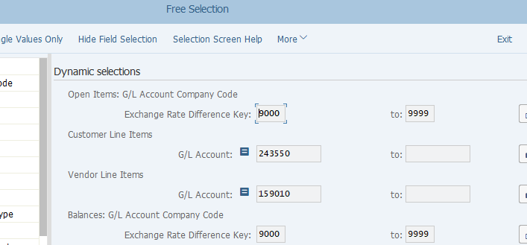
Currency Revaluation: Execution (4/4)
FAGL_FCV: Revaluation – Output /technical Settings tab
There is a specific layout that the GBS/JTBC has defined for the output log of Revaluation run. This layout allows all the output from all Revaluation runs to show the same columns every time when the same variant is executed, which also allows easier analysis if the output is to be downloaded to excel for further analysis using for example macros if needed.
As mentioned before we have activated some “Display Selections” (or Dynamic Selections) on several tabs of the Revaluation selection screen. You can see all of them together by clicking on the corresponding button on the menu bar.
The following dynamic selections have been activated for a typical Revaluation run:
Exchange Rate Different Key (ERDK)
This is for both G/L accounts with open items and G/L account balances.
ERDK range 9000-9999 are assigned for all G/L accounts which are monetary, therefore need to be included in Revaluation.
Refer to Chart of Accounts course material for details of ERDK.
Customer Line Items and Vendor Line Items
As you can see that we have excluded a number of customer/vendor reconciliation accounts from revaluation, e.g. down payment accounts, which has to be excluded at line item level as postings made to them are via the use of Special GL Indicators.
The global guidance on this comes from Corporate Accounting/R2R Competency Center, while specific exclusions for individual entities need to be approved by R2R Competency Center too.
FAGL_FCV: Menu bar

Slide 8
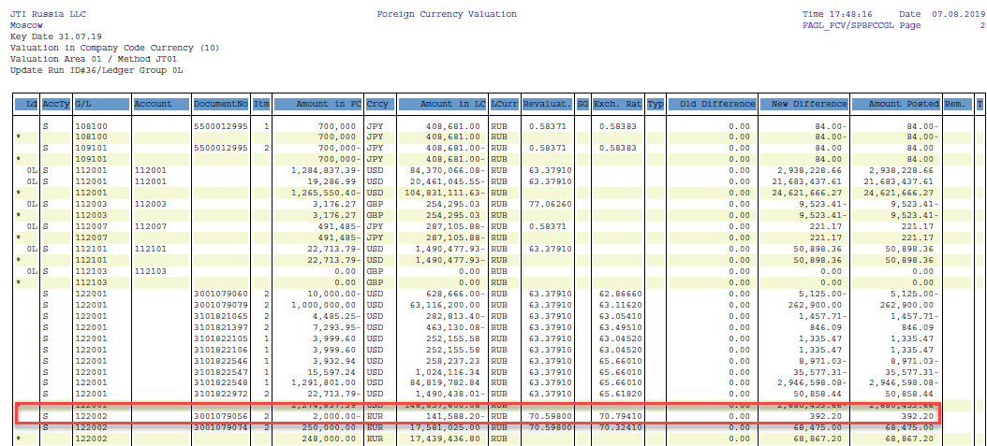

Currency Revaluation: Output
If you execute Revaluation outside of FCC, you will see an output looks like the below. You receive the same output from the Revaluation FCC task. The illustration below explains how the Revaluation is calculated using an example for IFRS revaluation, i.e. target currency is LC1.
FAGL_FCV: Revaluation – Output Log
Revaluated LC1 (RUB) =
(-2,000) * 70.598 = -141,196
UFX= -141,196 - (-141,588.20) = 392.20
Document Curr.
Original LC1
JT Rate
Original Rate
UFX calculated and posted
ZFCMA13 – Display FX Rate

Slide 9
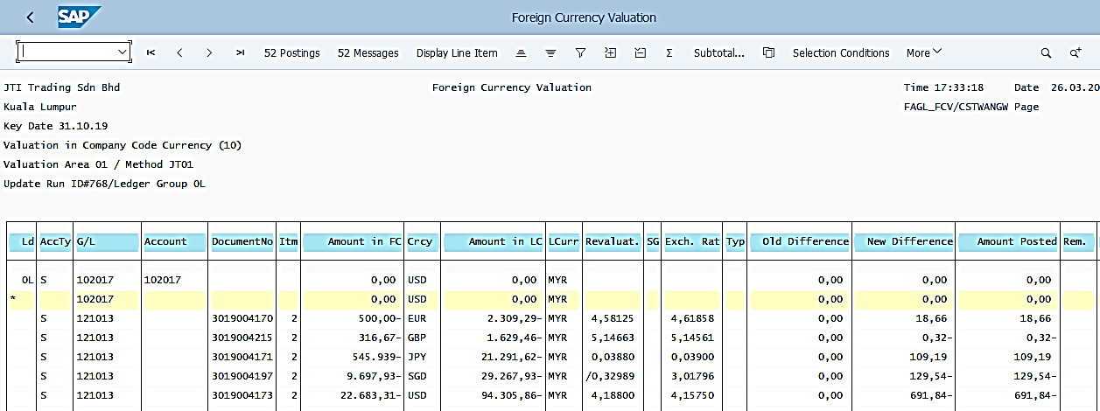
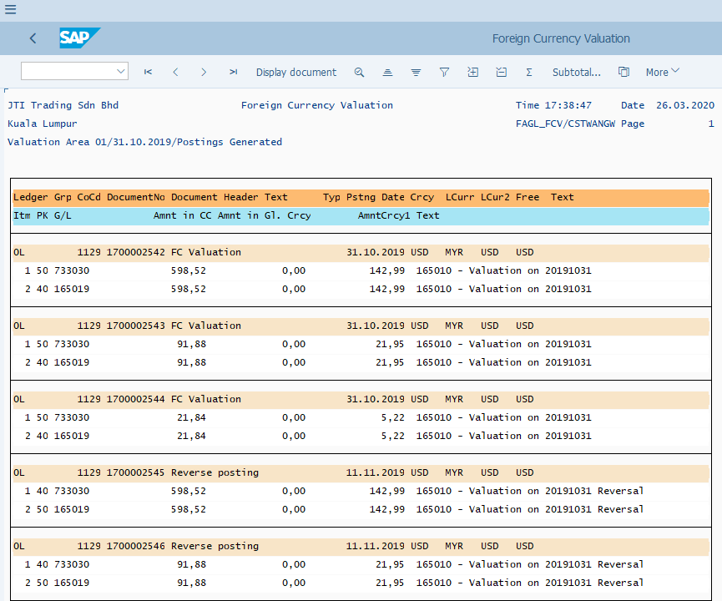
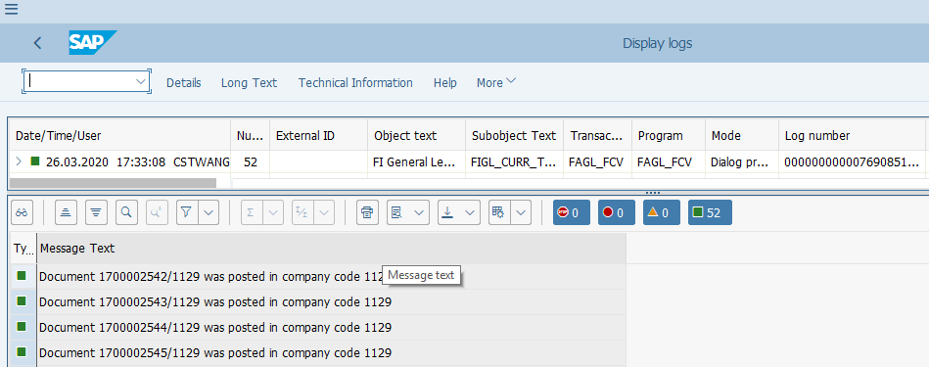
Currency Revaluation: Output
FAGL_FCV: Revaluation – Output Log
You should review and save the output log of FAGL_FCV if you execute it outside of FCC.
Postings log allows you to see the document posted (Revaluation and Reversal), which even allows you to Display the document directly from this screen if needed.
Messages are important especially when there are errors. You should Test Run this transaction to prevent critical errors during update run.

Slide 10
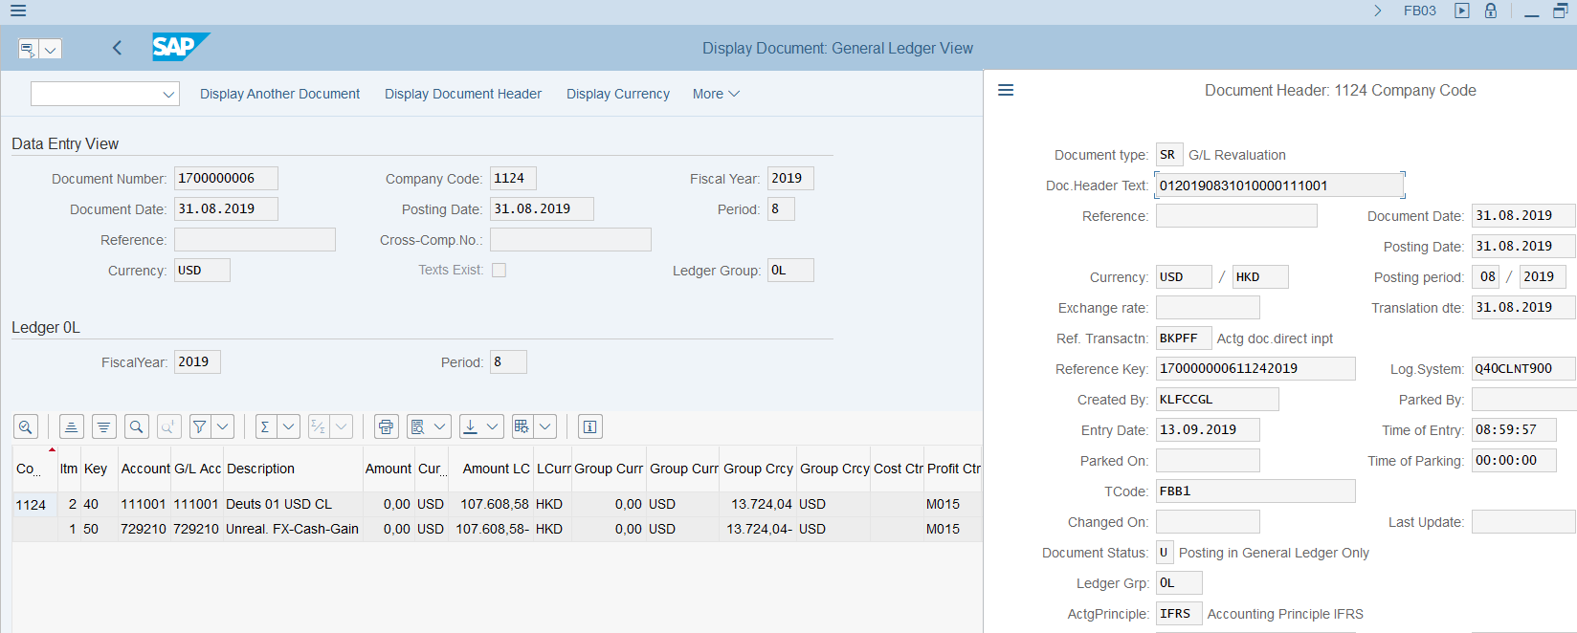
Currency Revaluation: Posting Example
Revaluation posting uses Doc. Type SR, same as in ECC.
Revaluation task is built in FCC, which is automatically triggered. Entities can display the job log and spool list in FCC.
Accounting entries on Revaluation documents are between the original account or FX adjustment accounts (for OIM, LSC and AR/AP Reconciliation accounts) and UFX Gain/Loss accounts. Refer to Currency Conversion section of Parallel Ledger course for how the values are calculated.
Revaluation is executed for each accounting principle separately using different valuation areas (explained in Parallel Ledger course). Postings are made to the corresponding ledger only.

Slide 11

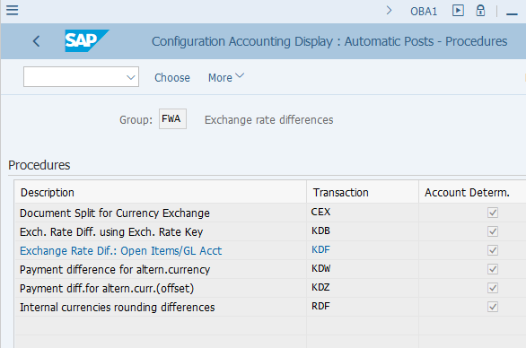
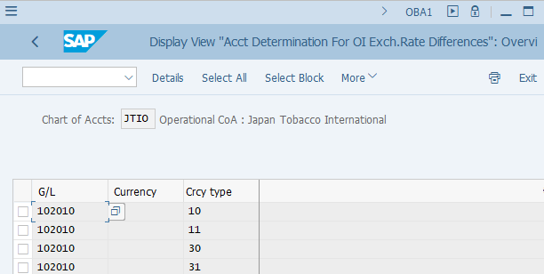
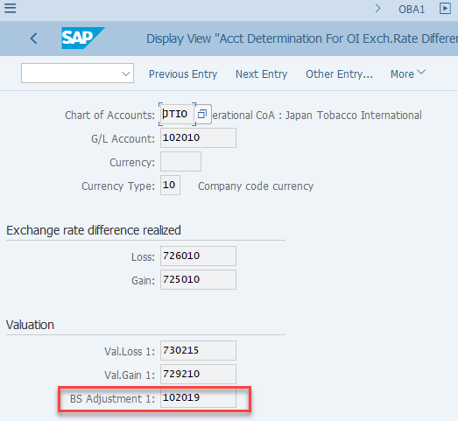
Currency Revaluation: FX Adjustment Accounts
In S/4 the FX Adjustment Accounts for Revaluation postings are still defined in OBA1. The authorized GBS/JTBC users can access this T-Code to check the corresponding FX Adjustment accounts when needed. ¹⁾ Only AP/AR Reconciliation accounts and Open Item Managed (OIM or LSC) accounts required FX Adjustment accounts. ²⁾ Other Balance Sheet Accounts included in Revaluation post the Revaluation results to themselves against UFX (Unrealised Foreign Exchange ) gain/loss accounts.
OBA1: Revaluation Posting Configuration
Revaluation is only relevant to currency type 10 – LC1.
Translation posting configuration is done separately in S/4 therefore the currency type 30 and 31 configurations listed in OBA1 is not relevant any more.
²⁾ Refer to Chart of Accounts training materials.
¹⁾ This is not a routine activity for end users. Authorized GBS/JTBC G/L users may want to perform this check during testing (e.g. test a newly created G/L account) or investigate any posting errors during period end Currency Revaluation. R2R CC should be contacted for any queries.

Slide 12
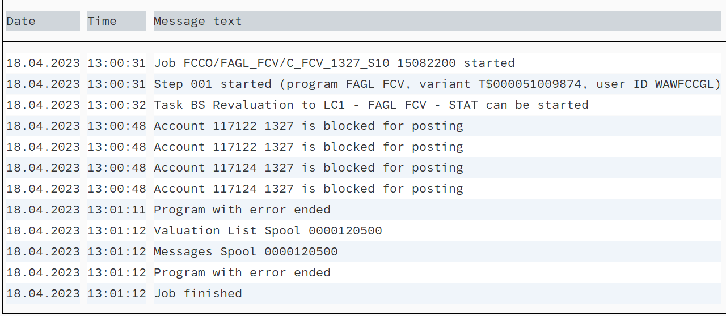
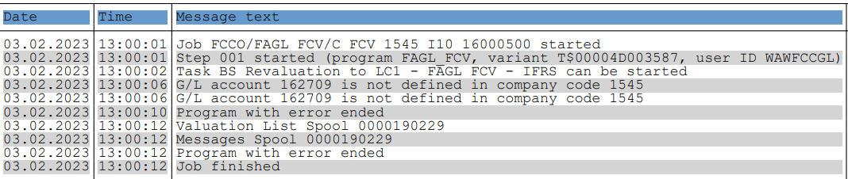
Currency Revaluation - Common Errors
Detail of the “Errors” can be checked from the “Output Logs”. GL Team needs to check the error and work as per the resolution mentioned below.
Errors | Error Description (Reason) | Resolution
Account XXX is blocked for posting | This error occurs when Account is not in use and block for the posting in Company Code. | GL Team needs to check the balance on the account: If there is a balance and amount is not material, GL Team contacts Market to unblock account aтd clean-up the balance for next period. If amount is material, GL Team needs to ask Market to unblock account for the same period. Once account is unblocked GL Team can run the revaluation for this particular account manually. If Market is not be able to unblock account quickly then HQ journal will be required. If account balance is zero GL Team needs to check whether posting on blocked account is zeroed out on Profit Center and/or Trading partner level. If not, GL Team needs contact market to perform necessary corrections, otherwise the system will be picking up these items for revaluation even though on the account level the balance is zero.
GL Account XXX is not defined in company code XXXX | This error occurs when Account is not created for Company Code. | GL Team needs to ask market to create the account for Company Code. If amount is immaterial, it is ok to change status to checked. If material, it might be a subject to HQ.

Slide 13
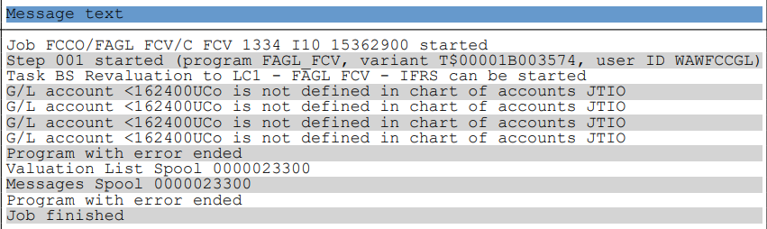
Currency Revaluation - Common Errors
Errors | Error Description (Reason) | Resolution
GL Account XXX is not defined in chart of accounts JTIO | This error occurs when the Account is not created on Chart of Account (CoA) level. Chart of Account (CoA)-”JTIO”. | GL Team to ask market to raise IT Request to update OBA1 table with proper adjustment account. If amount is immaterial, it is ok to change status to “checked”, if material it might be a subject to HQ.
Balancing field "Profit Center" not filled | This error occurs when Profit Center is entered in initial posting. | From S/4HANA perspective such items are not subject to revaluation. Moreover, such documents should not exist in the system at all. GL Team needs to skip such error messages during SM35 processing and discuss with Market how to correct incorrectly posted documents. Workaround - Enter a Profit Center number to clear the items.

Slide 14
Demonstration & exercises
Exercise No. 3: Perform Currency Revaluation using T-Code FAGL_FCV

